Slide 1



Top 250 Movies
View in Power BI
Last data refresh:
4/13/2021 2:15:43 AM GTB Standard Time
Downloaded at:
4/13/2021 2:05:47 PM GTB Standard Time

Slide 2
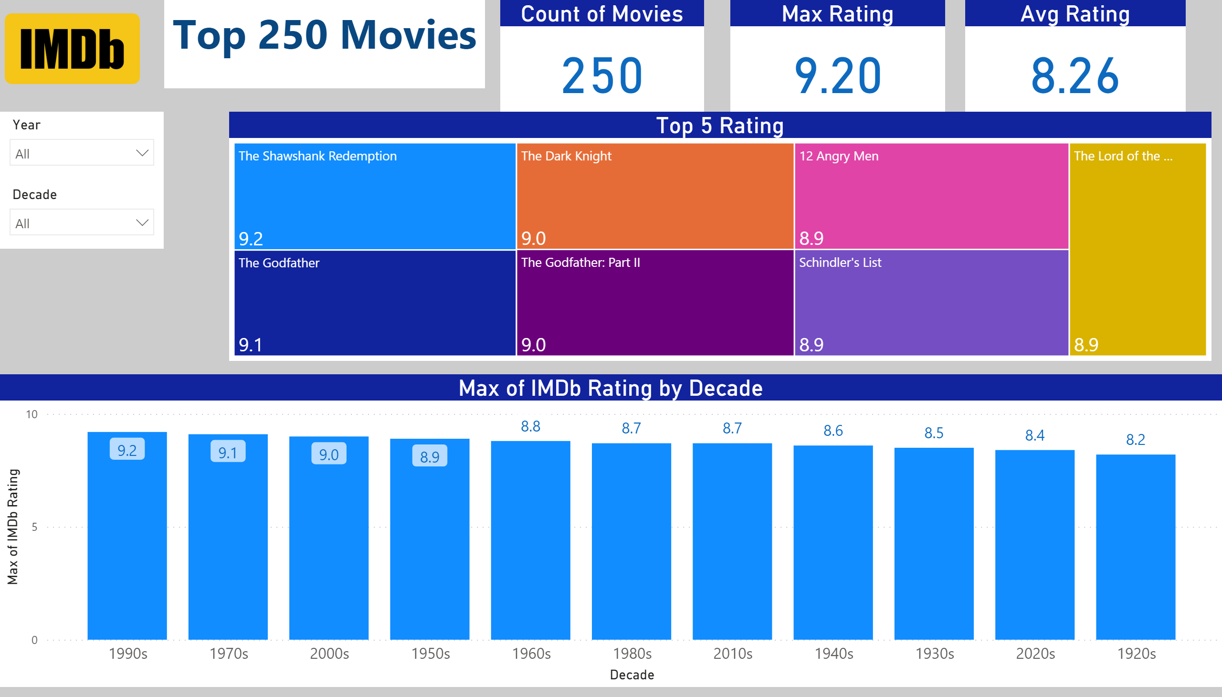
Top 250 Movies
Notes:
Count of Movies
No alt text provided.
lineStackedColumnComboChart
No alt text provided.
Max Rating
No alt text provided.
Avg Rating
No alt text provided.
textbox
No alt text provided.
slicer
No alt text provided.
slicer
No alt text provided.
image
No alt text provided.
Top 5 Rating
No alt text provided.

